Slide 1

Internship Project Report
Bike Sharing Demand Analysis Using Excel
Presented by: Vanshika Goel
Designation: Data Science Intern
Organization: Next Hikes IT Solutions

Slide 2
Objective & Scope
Objective: Analyze bike-sharing demand using Excel to uncover patterns in user behavior, weather impact, and time-based trends.
Scope:
- Data cleaning and merging from multiple sources
- Dashboard creation with dynamic filters
- Forecasting and automation using Excel tools and VBA
- Outcome: Deliver actionable insights and a client-ready dashboard.

Slide 3
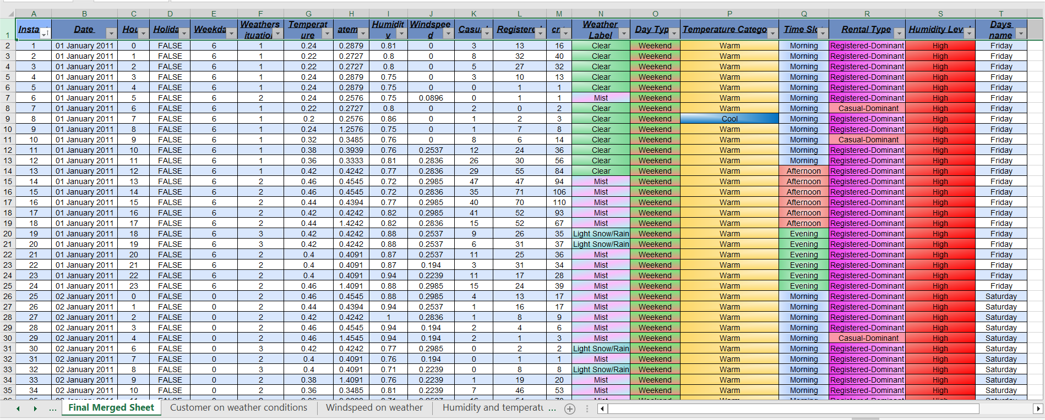
Data Cleaning & Preparation
- Merged datasets using Power Query and VLOOKUP
- Removed duplicates, handled missing values
- Applied conditional formatting and corrected data types

Slide 4
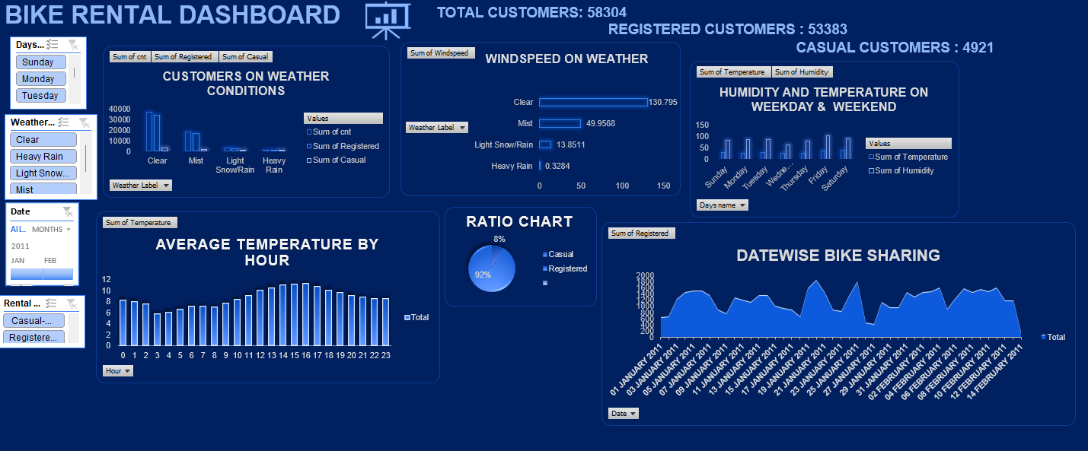

Slide 5
Casual users peak during clear weather
KEY INSIGHTS
Rentals rise with temperature, peaking in the late afternoon
Weekends show higher humidity impact

Slide 6
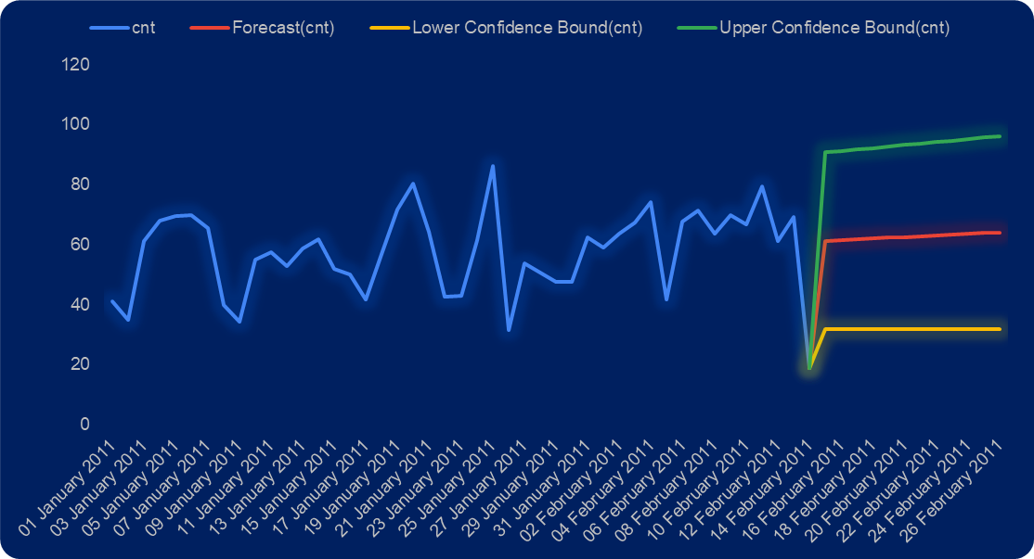
Forecasting & Automation
- Used Forecast Sheet for demand prediction
- Applied VBA Macros for automated data cleaning
- Enabled anomaly detection for trend analysis

Slide 7
Recommendations
1. Increase the number of available bikes during morning and evening peak hours to meet high demand.
2. Offer promotional discounts or weather-based pricing to encourage usage during misty or rainy conditions.
3. Implement automated dashboard updates to provide near real-time insights for management decisions.
4. Leverage historical trends to optimize fleet distribution across different zones and times.

Slide 8
Thank You
Acknowledgments: DigiCrome Academy and Nexthikes IT Solutions
Thank you for your guidance and support throughout this internship project.

